Slide 1
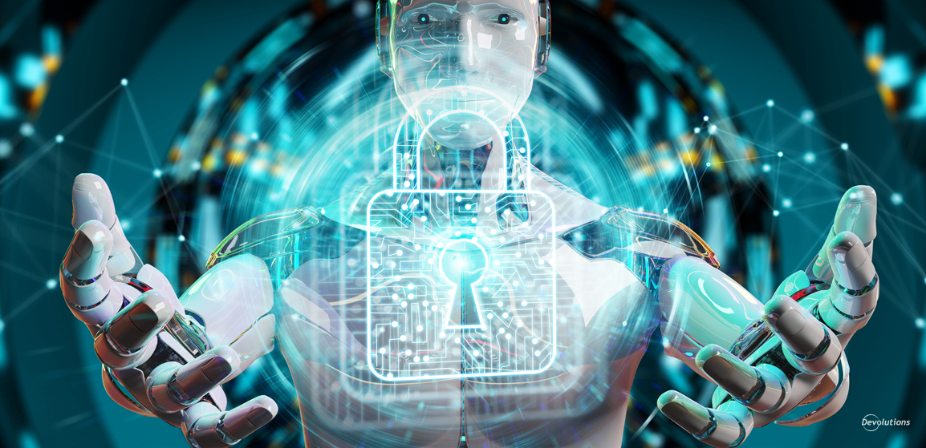
Artificial Intelligence for Smarter Cybersecurity
Eranda H . P . D
IT19029146

Slide 2
Outline
Abstract
Introduction to the topic
Evolution of the topic
Future developments in the area
Conclusion
2

Slide 3
Abstract
Report was created in order to fulfill the aim of creating awareness of current emerging topics in cyber security.
Thank you very much for the kind support and guidance.
So now, please allow me to provide you with a brief explanation about the content in this presentation.
3

Slide 4
Abstract
Under the “Introduction to the topic” section we are trying to achieve the basic and the general idea of the topic. This includes what is actually meant by “AI for smarter cyber security”.
Then under the section “Evolution of the topic”, we basically target the history of the usage and the gradual development of AI in cyber security. After that under this section we are going to discuss about the current situation, implementations and the modern trends related to that topic.
Then we are hoping to discuss about the “Future developments in the area”. Under this section we are going to discuss about the possibilities, predictions and the real world usage of artificial intelligence in cyber security.
After that we are going to wrap up the whole gathered information and create a final single conclusion.

Slide 5


Introduction to the topic
What is cyber security?
According to the world famous network company “cisco”, “Cybersecurity is the practice of protecting systems, networks, and programs from digital attacks.”
What is artificial intelligence
According to the builtin.com ““Artificial intelligence (AI) is wide-ranging branch of computer science concerned with building smart machines capable of performing tasks that typically require human intelligence.”

Slide 6
Introduction to the topic
Both artificial intelligence and cyber security can be considered as cutting-edge technologies.
If AI is aggregated with cyber security properly, most certainly it becomes the most powerful and the dangerous weapon of all time.
AI technology uses very complex and sophisticated algorithms in order to analyze large amounts of data.
Aggregation of AI with Cyber Security
Ex :- consider a powerful phishing attack which is capable of breaching the security defenses of a system. In such a scenario AI can boost the security of the system by investigating the sources of emails for possible threats.

Slide 7
Introduction to the topic
AI technology increases the speed of security products and also it reduces the costs when maintaining those security products.
Implementing AI in cyber security prevents security analysts from wasting their valuable time on researching false alerts and dead ends.
Contribution of AI in saving money & time

Slide 8
Evolution of the topic
At the very beginning cyber security and artificial intelligence are completely different pieces of technology.
Both of those massive technologies had their own paths and futures.
Actually, the artificial intelligence technology was discovered way before than the cyber security was discovered.

Slide 9
Evolution of the topic
The term “Artificial Intelligence” was first brought in by John McCarthy in 1956.
Later on AI began to spread widely into massive amount of sectors in the society including the cyber security sector.
If we concern about the history of cyber security, it draws back us to 1970s.
At those time periods there were no such words like ransomware, viruses, spyware, worms, SQL injection, cross-site scripting etc.

Slide 10
Evolution of the topic
Around 1998-1999, DARPA (the government agency that created the Internet) started to do researches in machine learning in cyber security.
AI uses machine learning in order to detect similarities and differences within a data set and report any anomalies. It is capable of finding previously unknown patterns in a data set without the use of pre-existing labels.
With the time being Cyber criminals have also become more powerful than ever especially in bypassing the firewalls of organizations using very complex and advanced mechanisms.

Slide 11
Evolution of the topic
Humans are not capable of detecting the abnormalities at the speed that the attacks happen.
However when AI is integrated into those systems, it get the ability to analyze a massive amount of data generated on a network in order to identify what doesn’t belong there.
A practical application of AI, machine learning helps in anti-malware, performing dynamic risk analysis and detecting anomaly.
Not only that AI technology can be used to train or learn when removing the noise or unwanted data and it assists security experts in understanding cyber environment for detection of any anomalous activity.

Slide 12
Evolution of the topic
Expert Systems (analyst-driven)
Expert systems are mostly developed and managed by people. Those systems are usually based on identification of threat signatures to prevent attacks
Ex: - a fingerprint database is used to capture the intruders and criminals.
Different cyber security systems
Automated Systems (machine-driven)
Automated systems are capable of identifying potentially harmful or dangerous actions in a system or network by analyzing the historical data.

Slide 13
Evolution of the topic
Automated Malware Defense
AI systems can be trained to identify even the slightest behaviors of ransomware and malware attacks before it enters the system.
In order to make this a reality a behavior-based algorithm was created. It not only analyzes the code directly, but also uses probability models on order to take into account multiple scenarios and attributes of the malicious code.
Even though this algorithm had huge amounts of drawbacks.
So later on a very effective algorithm was found out and it was called as “Heuristic algorithm”.
This AI powered algorithm was totally capable of making decisions about whether the analyzed code is harmful or not.
Practical usage of AI in cyber security

Slide 14
Evolution of the topic
2) Automated Phishing Detection
Phishing attacks are created in order to grab or steal your sensitive information such as login credentials, phone number, credit card numbers etc.
Rather than the general phishing attacks nowadays there is a very popular attack type called spear phishing attacks.
Spear phishers obtain private information of a specific user by researching the background of that particular individual and companies on social media, linked websites and other publicly available information.
So in a case like this, AI helps to classify the messages just like in email spam filters.
But initially you need to train the algorithm manually by labeling messages or reporting suspicious links. As AI is capable of self-learning, it constantly improves its accuracy.
Practical usage of AI in cyber security

Slide 15
Evolution of the topic
3) Automated Data Theft Detection
One of the most common threats that organizations are currently facing is data breaches. In such scenarios AI based algorithms can be heavily used to identify the stolen data.
Most of those stolen data are usually laid on the dark web.
In web browsers like “Tor” it’s possible to access the dark web and the connection is encrypted peer-to-peer.
Not only that there are some certain safeguards like CAPTCHA need to be applied too.
But with the help of the AI, it is possible to fool these systems by implying that the CAPTCHAs are done by a human.
Practical usage of AI in cyber security

Slide 16
Evolution of the topic
4) Honeypot-based Social Engineering Defense
Exploiting human psychology is simply called as social engineering.
Attackers use this technique in order to obtain personal information which leads for compromising security systems.
So in here, AI is used to make sure whether the sender is malicious or friendly.
This classification is done automatically and then it is disseminated to the devices of all the employees.
So that it automatically blocks further unnecessary communication attempts which are received from the offending party.
Practical usage of AI in cyber security

Slide 17
Future developments in the area
Cyber Security is a specialization which keeps on evolving constantly with the time.
Private business organizations and corporations have already deployed AI based cyber security systems. Not only that even some governments have also started using this technology.
There were some considerable amounts of cyber security trends in year 2019 too such as spear phishing attacks, Internet of Things (IoT) ransomware etc.
According to a research, currently one of every five organizations uses AI to enhance cyber security.

Slide 18
Future developments in the area
1) The end of passwords
Most of the people still use simple passwords or they use the same password for multiple user accounts.
So this has clearly made their accounts vulnerable to cyber-attacks.
But with the help of artificial intelligence technology it is possible to create a much safer online environment without passwords.
According to IAM, in near future, the passwords might actually be replaced by AI systems.
By using this idea, AI gets the ability to track each and every user within an organization based on roles, privileges, and common actions.
Future possibilities and predictions

Slide 19
Future developments in the area
2) Threat hunting
Threat hunting is a perfect AI based matured solution for disruption of data.
As a traditional technique, signatures and indicators are used to identify the threats which have been previously encountered.
Not only that, AI can be used to escalate the hunting process by merging with behavioral analysis.
Startups such as “ReaQta” are capable of influencing the AI models to develop profiles of every application within an organization’s network by absorbing the data which is produced in high volumes by different endpoints.
Future possibilities and predictions

Slide 20
Future developments in the area
3) Minimize human involvement in Cybersecurity
Any person who is dealing with cyber security needs to be observant at all the times.
But with the approach of AI, it is possible to shift the workload into the machines.
When compared with humans, the speed and the accuracy of those AI based algorithms are at top level.
Not only that, the errors which are done by the machines are also lesser compared to human.
Not only that AI algorithms can be developed in such a way to detect and track more than 10,000 phishing emails.
So powering up cyber security with AI is definitely going to increase the productivity and the effectiveness of detecting malicious activity in the future.
Future possibilities and predictions

Slide 21
Future developments in the area
Bypassing security controls
So as you have heard before, AI can be used for both good and bad in the field of cyber security.
It’s predicted that threat actors might influence analytics and AI in order to bypass security controls.
They are surely going to increase their use of AI algorithms in analyzing the defense mechanisms of their organizations.
So that the threat actors can adjust their attacks to their particular weak areas.
Future possibilities and predictions

Slide 22
Future developments in the area
5) Fighting AI with AI
Nowadays there is a considerable amount of very talented hackers in all around the world.
They are capable of using the AI technology in order to exploit vulnerabilities and gain access to valuable business systems and data.
So in near future, there would be a massive competition or may be a war between those 2 parties, in order to gain more control over AI.
So that the security experts need to keep keen eye on those hackers 24/7.
So according to the predictions, AI based solutions might be used in the future in order to prevent AI based cyber-attacks.
Future possibilities and predictions

Slide 23
Conclusion
So now, let’s wrap up all the things we have discussed so far related to this topic.
Cyber criminals have begun to use more sophisticated and more complex mechanisms to perform cyber-attacks.
So in order to mitigate such kinds of attacks, cyber security experts had no other options left rather than integrating AI technology with cyber security.
The biggest advantage of AI based cyber security is that it has the ability to automate threat detection at a lightning speed.

Slide 24
Conclusion
As a positive side effect, reducing the human involvement in security processes causes less errors and mistakes.
In near future, password protection and authenticity detection systems are going to be compromised.
Biometric login mechanisms such as fingerprints, retina scans, palm scans and face scans have to be used in future in order to prevent form such kinds of attacks.
Artificial intelligence is an open technology. It can be used either to protect the systems or to exploit the systems.

Slide 25
Conclusion
So it’s massive responsibility of the security experts to prevent AI technology from going into the wrong hands.
In the near future, there might be ransomware attacks on cloud storage technology too.
So it’s better to do research complying with AI and stay on alert to face such kind of crisis in the future.
According to me, I believe that in future the traditional apps are not going to last much longer.
Researches have to be done in order to give those apps the ability of self-healing from cyber-attacks.

Slide 26
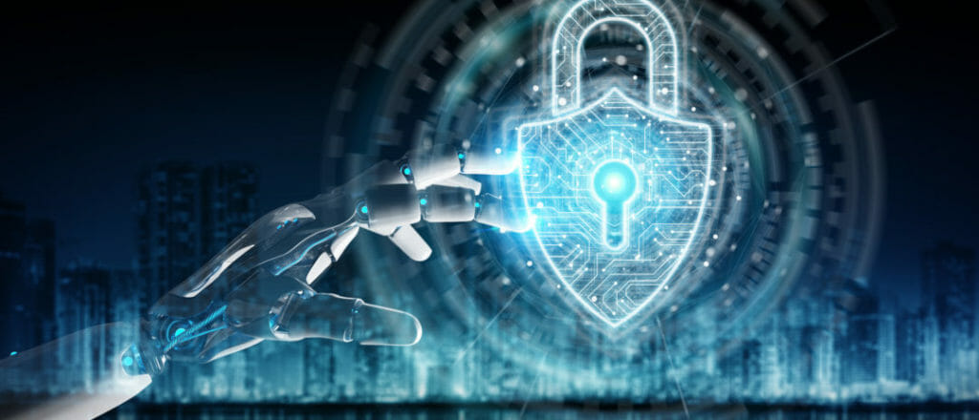
Artificial Intelligence for Smarter Cybersecurity
- THANK YOU -

